Slide 1
Game
Portal
BY: HARI OM NARAYAN

Slide 2
Applications used
MySQL is an open-source RDBMS. We can connect our webpage with MySQL database and can record the data in the backend and can access , modify and monitor that in a efficient way..
PHP is a popular general-purpose scripting language that is especially suited to web development. On a web server, the result of the interpreted and executed PHP code – which may be any type of data, such as generated HTML or binary image data would form the whole or part of a HTTP response..
HTML is the standard mark-up language for documents designed to be displayed in a web browser.HTML describes the structure of a web page semantically and originally included cues for the appearance of the document.
CSS is designed to enable the separation of presentation and content, including layout, colours, and fonts.

Slide 3
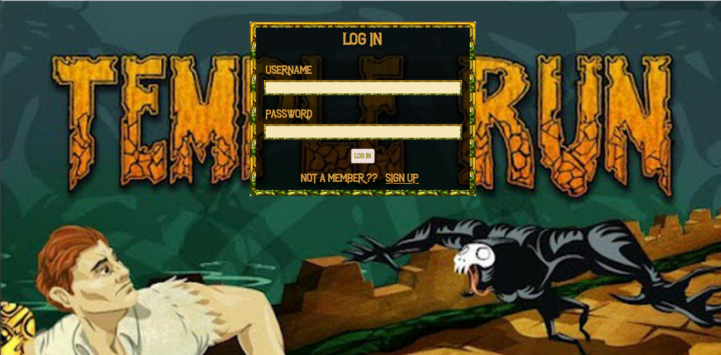
Log in page

Slide 4
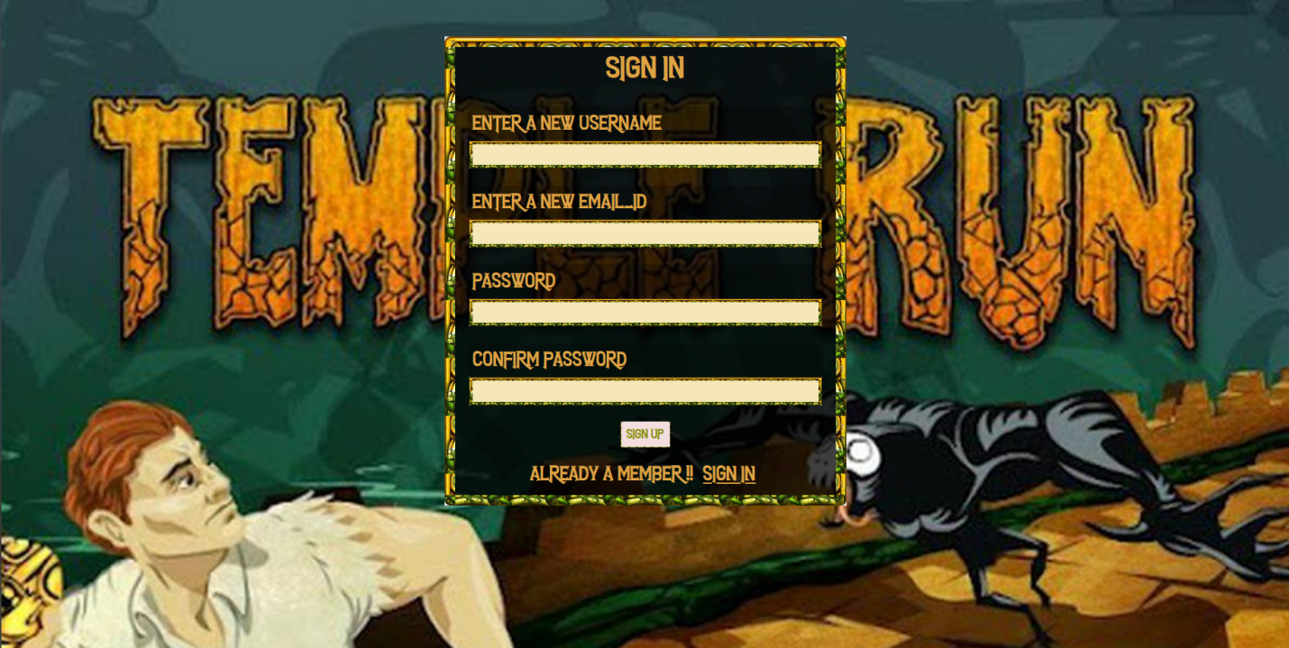
Sign in page

Slide 5
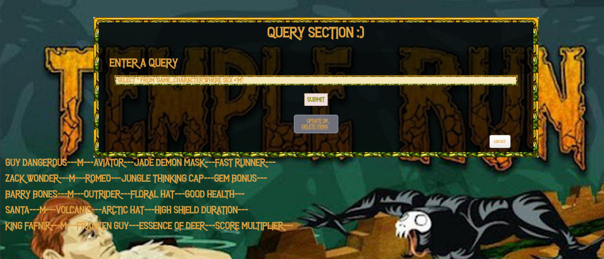
Creating a query page

Slide 6
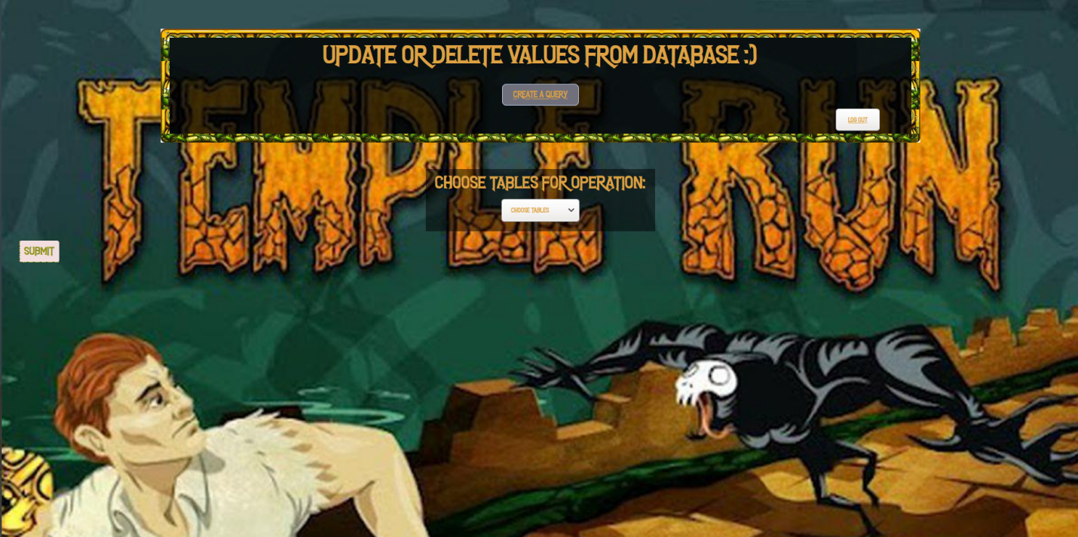
Insertion or deletion of values

Slide 7
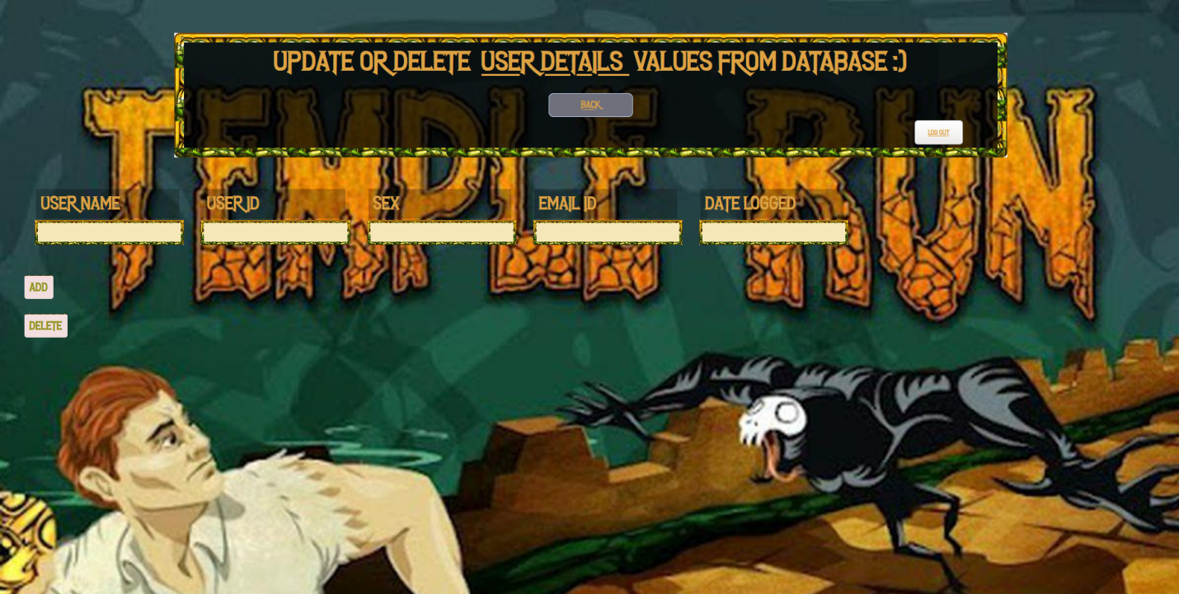
Different attributes of the game

